Slide 1
Applying Machine Learning Techniques to eSports
by John Chmielowiec and Ritwik Katiyar

Slide 2
Introduction to eSports
Money
sponsorships of teams/players/tournaments
advertising on content streams
prize pools for players
Entertainment
Spectating
Playing

Slide 3
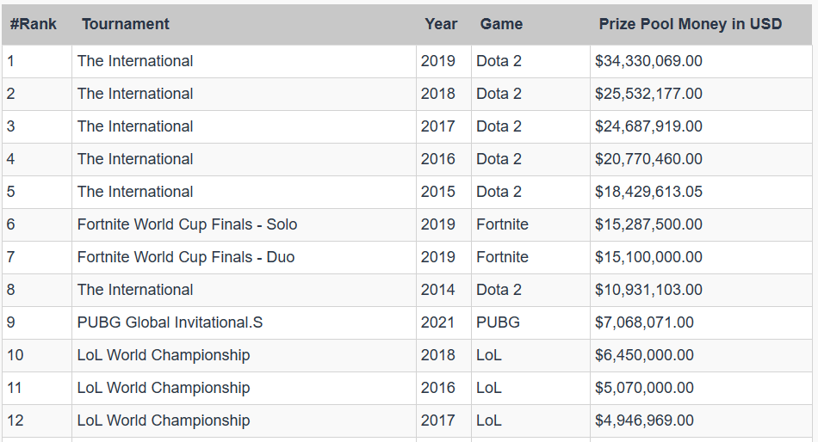
Introduction to eSports
Largest prize pools as of August 16, 2021

Slide 4
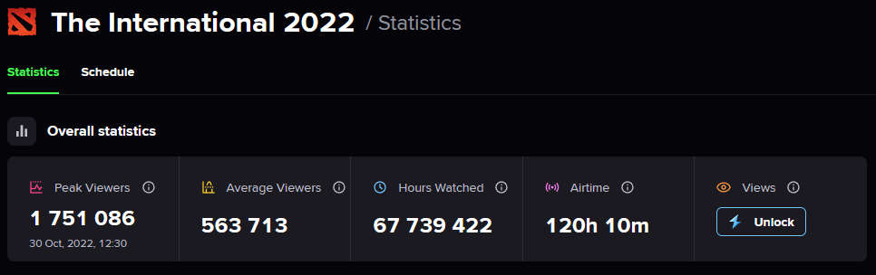
Introduction to eSports
Number of viewers
Time watched
Hours of content

Slide 5
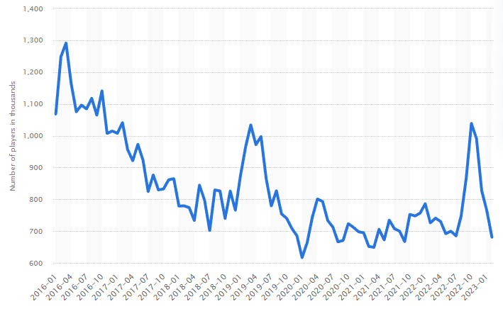
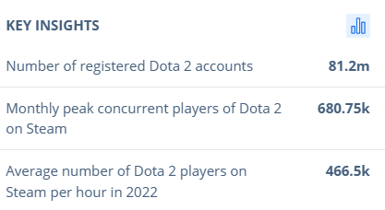
Introduction to eSports
Monthly number of peak concurrent players of Dota 2 on Steam worldwide as of February 2023
Extremely high numbers of active players

Slide 6
Introduction to League of Legends
Two teams
5 players on each team
Each has a base. The objective is to destroy the enemy base.
Base endless creates an army to help attack and defend.
Champions
Each player chooses from over 150 champions with unique abilities.
During the selection process, players also ban specific champion from play.
General Gameplay
Assault enemy base, killing enemies to earn experience and gold.
Experience will increase the power of a champion’s abilities.
Gold allows items to be bought to further customize a champion.

Slide 7
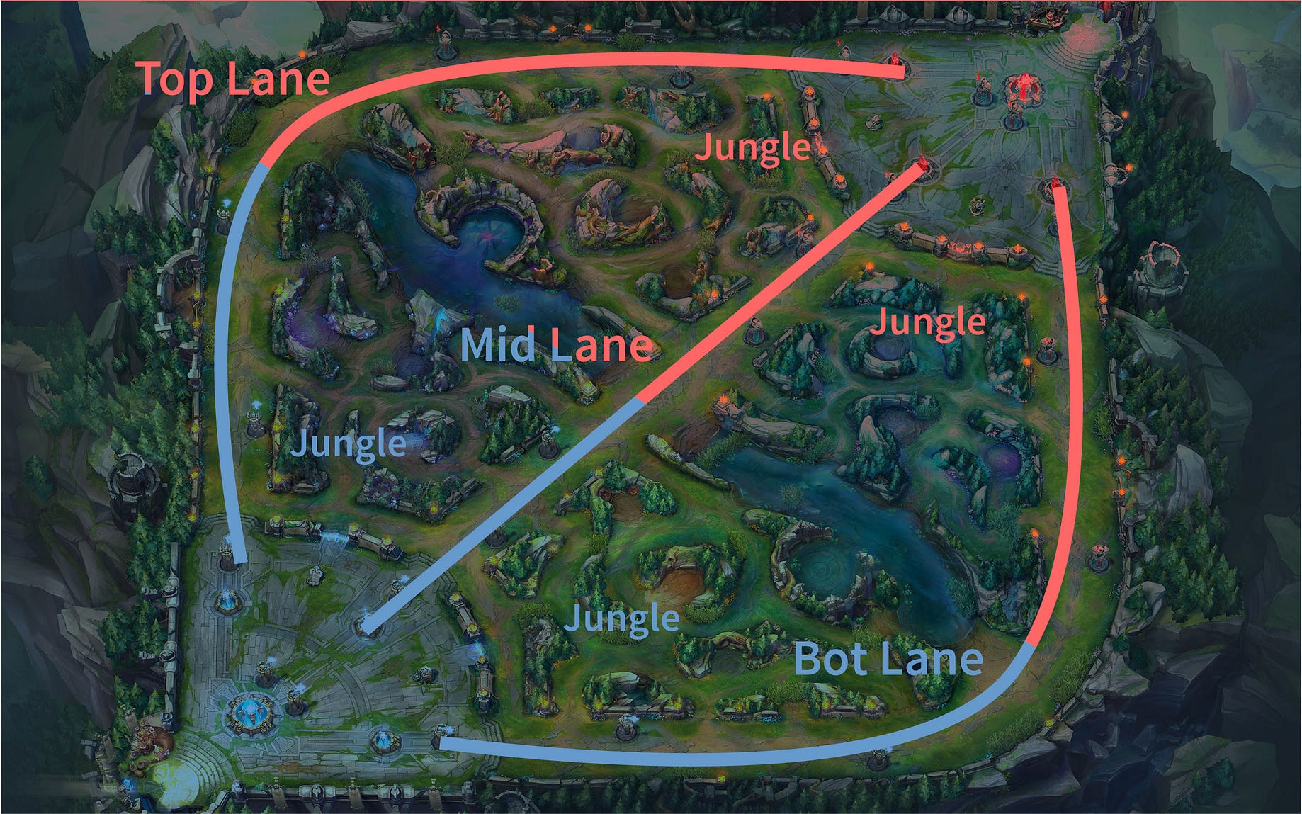
Introduction to League of Legends
Map
Lanes
Vision (fog of war)
Wards

Slide 8
Introduction to League of Legends
Objective
Baron: Highly contested, spawns after 20 minutes, can trigger endgame
Dragon: similar to baron, but available more frequently, with smaller rewards
Roles
Top, Bottom, Middle
Support
Jungle

Slide 9
Data Cleaning and Exploration
eSports match data for 2023
123 features
72,552 observations
Cleaning Process
Separate Players from Teams
Separate Complete Player information from Partial Player Information
Some Leagues only report a subset of the total features
Removed features not applicable to the analysis
Removed features that had too much missing data to be of use
Check for invalid data on the categorical features
Examine remaining data programmatically and via graph visualizations.

Slide 10
Data Cleaning and Exploration
 | datacompleteness | league | side | position | playername | teamname | champion | result | kills | dragons
0 | complete | LFL2 | Blue | top | Wylenz | Klanik Esport | Jax | 1 | 4 | NaN
1 | complete | LFL2 | Blue | jng | Julbu | Klanik Esport | Poppy | 1 | 2 | NaN
2 | complete | LFL2 | Blue | mid | Sintax | Klanik Esport | Taliyah | 1 | 2 | NaN
3 | complete | LFL2 | Blue | bot | Axelent | Klanik Esport | Ezreal | 1 | 5 | NaN
4 | complete | LFL2 | Blue | sup | Wixo | Klanik Esport | Karma | 1 | 0 | NaN
5 | complete | LFL2 | Red | top | Anathar | MS Company | Sejuani | 0 | 0 | NaN
6 | complete | LFL2 | Red | jng | nicolaiy | MS Company | Viego | 0 | 0 | NaN
7 | complete | LFL2 | Red | mid | Kuroneel | MS Company | Syndra | 0 | 3 | NaN
8 | complete | LFL2 | Red | bot | Scripter | MS Company | Zeri | 0 | 3 | NaN
9 | complete | LFL2 | Red | sup | Zimba | MS Company | Yuumi | 0 | 1 | NaN
10 | complete | LFL2 | Blue | team | NaN | Klanik Esport | NaN | 1 | 13 | 4.0
11 | complete | LFL2 | Red | team | NaN | MS Company | NaN | 0 | 7 | 3.0
Initial Dataset Example

Slide 11
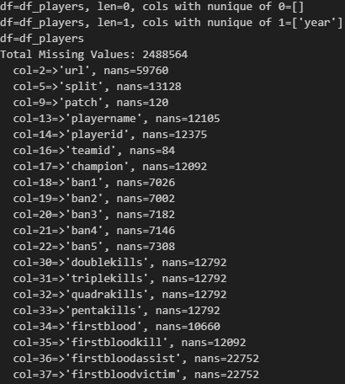
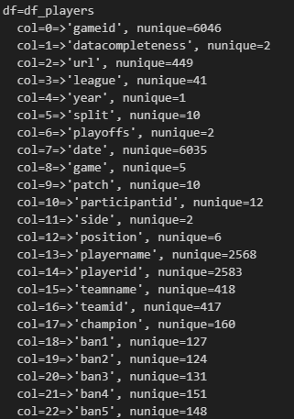
Data Cleaning and Exploration
Debugging Function Output

Slide 12
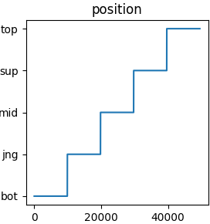
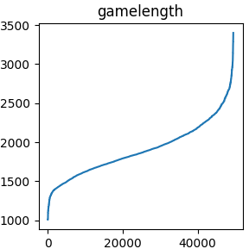
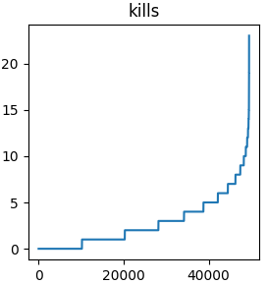
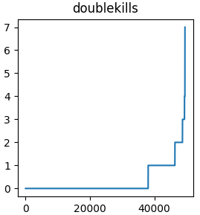
Data Cleaning and Exploration
Data Visualization (sorted features)

Slide 13
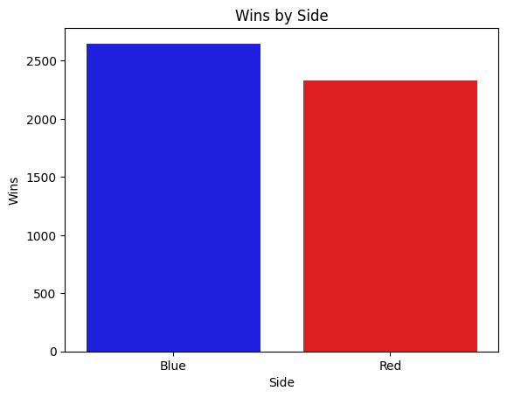
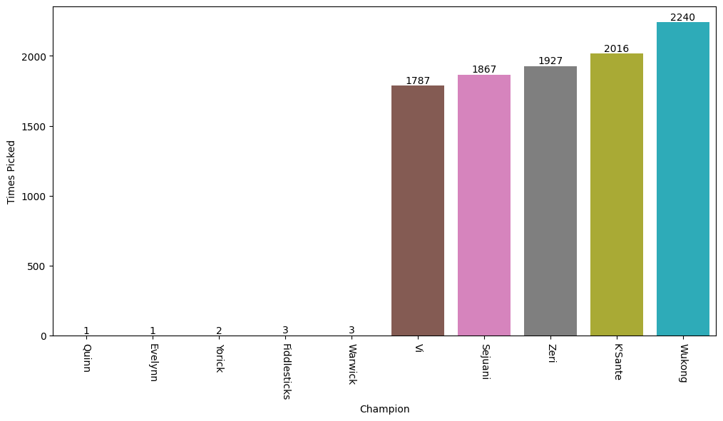
Data Cleaning and Exploration
Top 5 Picks, Bottom 5 Picks
Do the distributions of data points make sense?
Does the data make sense given preexisting domain knowledge?

Slide 14
3 Questions
Frequent Champion Itemsets
What champions are frequently picked together?
Player Performance Analysis
What features are important to the commonly used KDA metric?
Game Predictions
Can the outcome of a new game be predicted using existing data?

Slide 15
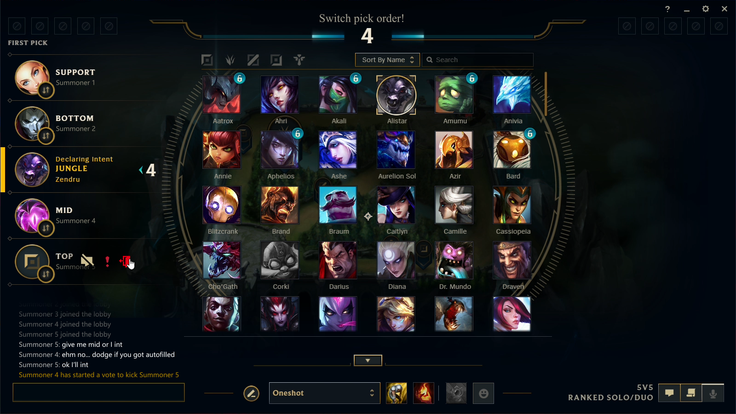
Frequent Champion Itemsets
Champion Select Phase
Similar to Draft Selection
Also deny selections to opposing team
Done before every game

Slide 16
Frequent Champion Itemsets
 | antecedents | consequents | support | confidence | lift | conviction
1 | (Nami) | (Lucian) | 0.087952 | 0.942949 | 9.732410 | 15.830028
0 | (Lucian) | (Nami) | 0.087952 | 0.907772 | 9.732410 | 9.831365
3 | (Lulu) | (Zeri) | 0.065562 | 0.600736 | 3.887804 | 2.117601
5 | (Rakan) | (Xayah) | 0.052510 | 0.443220 | 3.678729 | 1.579652
4 | (Xayah) | (Rakan) | 0.052510 | 0.435833 | 3.678729 | 1.562528
2 | (Zeri) | (Lulu) | 0.065562 | 0.424301 | 3.887804 | 1.547448
Apriori results, Support Threshold = 0.05

Slide 17
Frequent Champion Itemsets
 | antecedents | consequents | support | confidence | lift | conviction
7 | (Nami) | (Lucian) | 0.087952 | 0.942949 | 9.732410 | 15.830028
6 | (Lucian) | (Nami) | 0.087952 | 0.907772 | 9.732410 | 9.831365
9 | (Lulu) | (Zeri) | 0.065562 | 0.600736 | 3.887804 | 2.117601
1 | (Thresh) | (Aphelios) | 0.025703 | 0.504931 | 4.635127 | 1.799879
15 | (Rakan) | (Xayah) | 0.052510 | 0.443220 | 3.678729 | 1.579652
14 | (Xayah) | (Rakan) | 0.052510 | 0.435833 | 3.678729 | 1.562528
8 | (Zeri) | (Lulu) | 0.065562 | 0.424301 | 3.887804 | 1.547448
3 | (Jayce) | (Maokai) | 0.025904 | 0.271865 | 2.279273 | 1.209560
0 | (Aphelios) | (Thresh) | 0.025703 | 0.235945 | 4.635127 | 1.242183
13 | (Rakan) | (Wukong) | 0.026908 | 0.227119 | 1.257422 | 1.060159
Apriori results, Support Threshold = 0.025

Slide 18
Frequent Champion Itemsets
 | antecedents | consequents | support | confidence | lift | conviction
258 | (Gnar, Nami) | (Lucian) | 0.012048 | 0.960000 | 9.908394 | 22.577811
252 | (Nami, Azir) | (Lucian) | 0.010843 | 0.955752 | 9.864551 | 20.410341
251 | (Lucian, Azir) | (Nami) | 0.010843 | 0.947368 | 10.156932 | 17.227811
281 | (Nami, Sejuani) | (Lucian) | 0.013855 | 0.945205 | 9.755696 | 16.481802
274 | (Lucian, Maokai) | (Nami) | 0.011747 | 0.943548 | 10.115976 | 16.062020
163 | (Nami) | (Lucian) | 0.087952 | 0.942949 | 9.732410 | 15.830028
286 | (Nami, Vi) | (Lucian) | 0.016265 | 0.941860 | 9.721171 | 15.533534
276 | (Maokai, Nami) | (Lucian) | 0.011747 | 0.936000 | 9.660684 | 14.111132
291 | (Nami, Wukong) | (Lucian) | 0.015763 | 0.934524 | 9.645448 | 13.792990
280 | (Lucian, Sejuani) | (Nami) | 0.013855 | 0.932432 | 9.996800 | 13.419558
Apriori results, Support Threshold = 0.01

Slide 19
Frequent Champion Itemsets
 | antecedents | consequents | support | confidence | lift | conviction
302 | (Lulu, Vi) | (Zeri) | 0.012450 | 0.673913 | 4.361387 | 2.592811
296 | (Lulu, Sejuani) | (Zeri) | 0.012651 | 0.656250 | 4.247076 | 2.459584
308 | (Wukong, Lulu) | (Zeri) | 0.012952 | 0.629268 | 4.072458 | 2.280576
181 | (Lulu) | (Zeri) | 0.065562 | 0.600736 | 3.887804 | 2.117601
270 | (K'Sante, Lulu) | (Zeri) | 0.011747 | 0.590909 | 3.824207 | 2.066734
39 | (Thresh) | (Aphelios) | 0.025703 | 0.504931 | 4.635127 | 1.799879
249 | (Yuumi) | (Zeri) | 0.018976 | 0.517808 | 3.351118 | 1.753414
295 | (Zeri, Sejuani) | (Lulu) | 0.012651 | 0.488372 | 4.474872 | 1.741233
312 | (Wukong, Xayah) | (Rakan) | 0.012149 | 0.487903 | 4.118234 | 1.721405
62 | (Caitlyn) | (Lux) | 0.022088 | 0.424710 | 15.725338 | 1.691308
...
108 | (Heimerdinger) | (Varus) | 0.016566 | 0.421995 | 3.097324 | 1.494373
Apriori results, Support Threshold = 0.01, sorted by Conviction

Slide 20
Player Performance Analysis
KDA
Kills, Deaths, Assists
Kill Death Ratio: (K+A)/D
Valuable and easy to understand metric
Kills is straightforward measure of offensive capability
Assists demonstrate teamwork
Deaths show how much a player is overcommitting themselves
All three measure player skill, situational awareness, and in-game power
What are the specific factors that contribute to a player’s KDA?

Slide 21
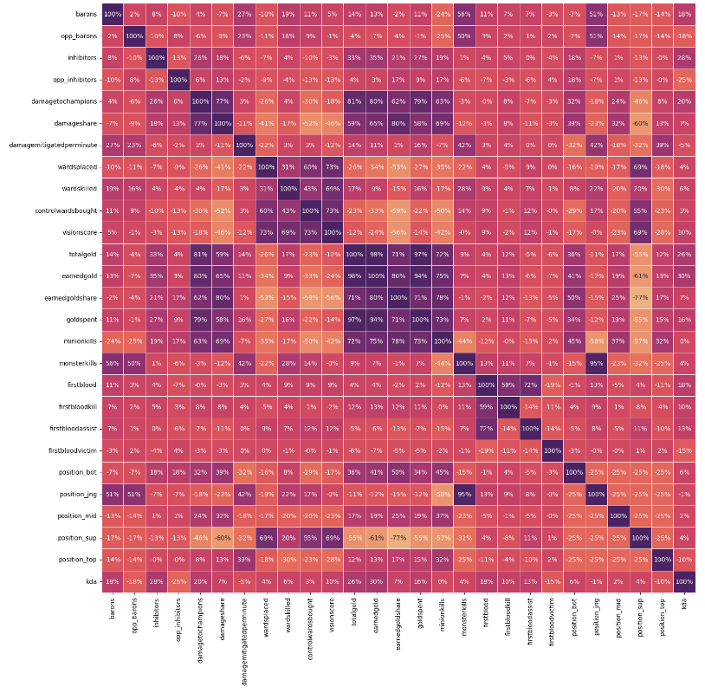
Player Performance Analysis
Feature Correlation Matrix
Too many redundant features
Standardized the data and performed feature selection
Configuring the Correlation Matrix
Manual inspection
Programmatically removing values over a specified threshold.

Slide 22
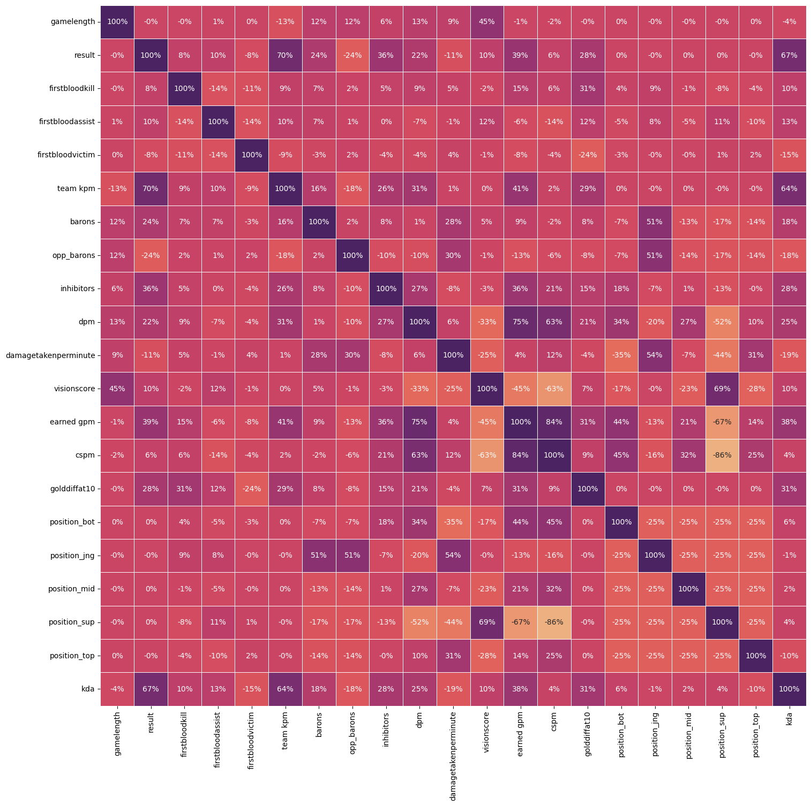
Player Performance Analysis
Removed redundant features
Wards kills
Wards placed
Vision score
Manual feature selection before algorithmic feature selection

Slide 23
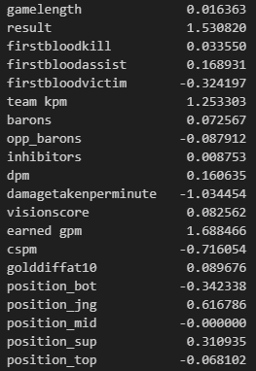
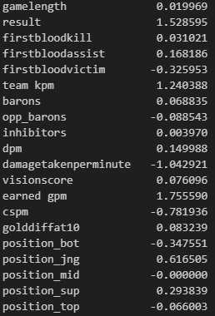
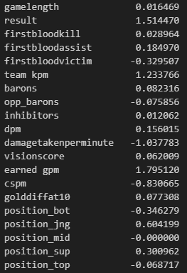
Player Performance Analysis
Elastic Net
Alpha: 0.006613574935661336
MSE: 10.62266328957894
RMSE: 3.2592427478754846
Elastic Net | Lasso (1st Model) | Lasso (2nd Model)
Lasso (1st Model)
Alpha: 0.003306787467830671
MSE: 10.462391247702186
RMSE: 3.234561986993322
Lasso (2nd Model)
Alpha: 0.003306787467830671
MSE: 9.618834866112751
RMSE: 3.2592427478754846

Slide 24
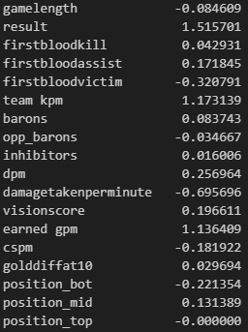
Player Performance Analysis
Lasso (3rd Model)
Remove Jungle and Support players
Lasso (3rd Model)
Alpha: 0.003306787467830671
MSE: 9.618834866112751
RMSE: 3.2592427478754846

Slide 25
Predicting Results of Matches
Most important aspects of sports analytics: predicting winners.
First approach: White box models
Important to understand how a model makes decisions
Logistic Regression
Second approach: Black box models
Random Forest
Neural Networks

Slide 26
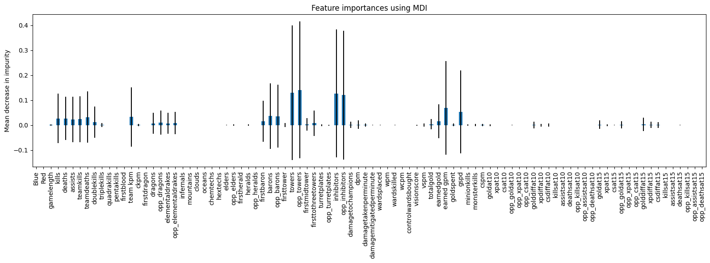
Predicting Results of Matches
Random Forest results

Slide 27
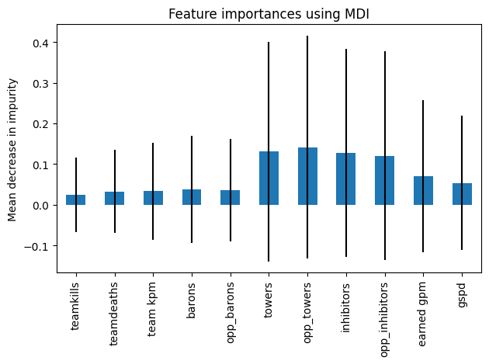
Predicting Results of Matches
Random Forest results, importance ≥ 0.02

Slide 28
Predicting Results of Matches
coef | std err | z | P>|z| | [0.025 | 0.975]
Intercept | -19.3729 | 2.644 | -7.326 | 0.000 | -24.556 | -14.190
teamkills | 0.5195 | 0.083 | 6.286 | 0.000 | 0.357 | 0.681
teamdeaths | -0.4173 | 0.036 | -11.509 | 0.000 | -0.488 | -0.346
team_kpm | -11.2241 | 3.159 | -3.553 | 0.000 | -17.416 | -5.032
barons | -0.2478 | 0.290 | -0.854 | 0.393 | -0.817 | 0.321
opp_barons | -0.2202 | 0.287 | -0.766 | 0.444 | -0.783 | 0.343
towers | 1.2213 | 0.136 | 8.970 | 0.000 | 0.954 | 1.488
opp_towers | -1.6059 | 0.136 | -11.771 | 0.000 | -1.873 | -1.339
inhibitors | -0.5160 | 0.173 | -2.991 | 0.003 | -0.854 | -0.178
opp_inhibitors | 0.5090 | 0.166 | 3.068 | 0.002 | 0.184 | 0.834
earned_gpm | 0.0224 | 0.003 | 8.233 | 0.000 | 0.017 | 0.028
gspd | -40.4736 | 3.514 | -11.518 | 0.000 | -47.361 | -33.587
Generalized Linear Model Regression Results
Dep. Variable: | results | No. Observations: | 9956
Model: | GLM | Df Residuals: | 9944
Model Family: | Binomial | Df Model: | 11
Link Function: | Logit | Scale: | 1.0000
Method: | IRLS | Log-Likelihood: | -176.82
Date: | Thu, 22 Jun 2023 | Deviance: | 353.64
Time: | 17:52:57 | Pearson chi2: | 963.
No. Iterations: | 11 | Pseudo R-squ. (CS): | 0.7410
Logistic Regression results

Slide 29
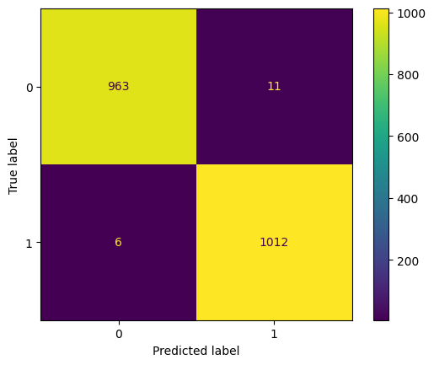
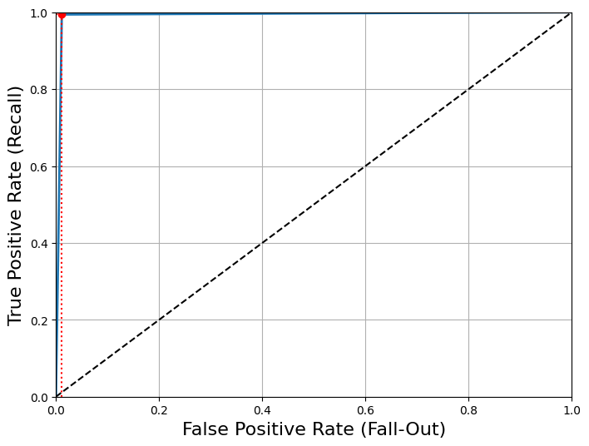
Predicting Results of Matches
Logistic Regression results

Slide 30
Predicting Results of Matches
Neural Network 1
Used the same teams DataFrame we used for the rest of the analysis.
Problem: It only examines a single team at a time.
This resulted in the same that logistic regression had

Slide 31
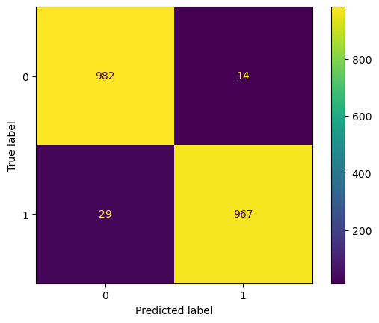
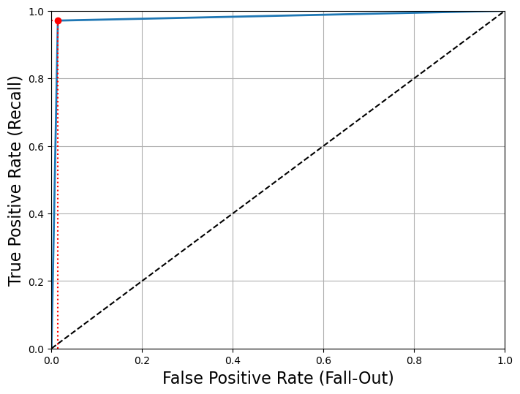
Predicting Results of Matches
Results were hard to interpret.
Probability of win for Team 1 (Gen. G): 0.9717535223444301
Probability of win for Team 2 (T1): 0.9981001104404654
roc score: 0.9784136...

Slide 32
Predicting Results of Matches
Neural Network 2
Manipulated the teams DataFrame to better suit the problem.
Used the features from the random forest.
index | Side | Gold_Earned
1 | Red | 23,020
2 | Blue | 18,422
3 | Red | 30,991
4 | Blue | 27,634
index | Side_red | Gold_Earned_red | Side_blue | Gold_Earned_blue
1 | Red | 23,020 | Blue | 18,422
2 | Red | 30,991 | Blue | 27,634
Individual Teams
Combined every record for any give team by taking the average of desired features.
Combined the records for given two teams using the same method.

Slide 33
Predicting Results of Matches
Neural Network performance
neural network train score=1.0
neural network test score=0.9909638554216867
both correct=987 (99.0964%)
one correct=1 (0.1004%)
neither correct=8 (0.8032%)
Neural Network Tuning
Estimator: Grid Search Validation
Alpha = 0.001

Slide 34
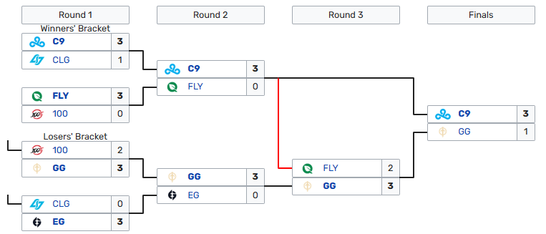
Predicting Results of Matches
'Cloud9' defeated 'Counter Logic Gaming' in Upper Bracket Semifinals 1 [Correct Prediction]
'FlyQuest' defeated '100 Thieves' in Upper Bracket Semifinals 2 [Correct Prediction]
'GoldenGuardians' defeated '100 Thieves' in Lower Bracket Quarterfinals 1 [Correct Prediction]
'Evil Geniuses' defeated 'Counter Logic Gaming' in Lower Bracket Quarterfinals 2 [Correct Prediction]
'GoldenGuardians' defeated 'Evil Geniuses' in Lower Bracket Semifinals [Correct Prediction]
'Cloud9' defeated 'FlyQuest' in Upper Bracket Finals [Correct Prediction]
'GoldenGuardians' defeated 'FlyQuest' in Lower Bracket Finals [Correct Prediction]
'Cloud9' defeated 'GoldenGuardians' in Grand Final [Correct Prediction]
Correct Predictions: 8 (100.0%)

Slide 35
Analytical Conclusions
We were able note interesting associations in champion groupings
KDA analysis revealed that a few ways to have higher scores
have more battlefield awareness (e.g vision of the map)
selectively group with others for group conflicts
Dataset may be too simple to consistently and accurately predict game results.
Our neural network showed 100% correct predictions on this run, but prediction accuracy ranged from 3/8 to 8/8.
League of Legends is a very complicated game due to the number of champions and items present.

Slide 36
Further Work
Dataset focuses on game results
Does not contain data about moment to moment performance.
No information about the upgrade path a player chose (e.g. how they spent experience and gold.)
This additional data may allow predictions based on teams of specific players instead of predefined groups.
Combining more detailed datasets with the one used here might allow for greater understanding of the game.

Slide 37



Happy Data Sciencing!

